Slide 1
Unit-4
Clustering

Slide 2
Clustering
Document clustering
  Motivations
  Document representations
  Success criteria
Clustering algorithms
  Partitional
  Hierarchical

Slide 3
What is clustering?
Ch. 16
Clustering: the process of grouping a set of objects into classes of similar objects
  Documents within a cluster should be similar.
  Documents from different clusters should be dissimilar.
The commonest form of unsupervised learning
    Unsupervised learning = learning from raw data, as opposed to supervised data where a classification of examples is given
  A common and important task that finds many applications in IR and other places

Slide 4
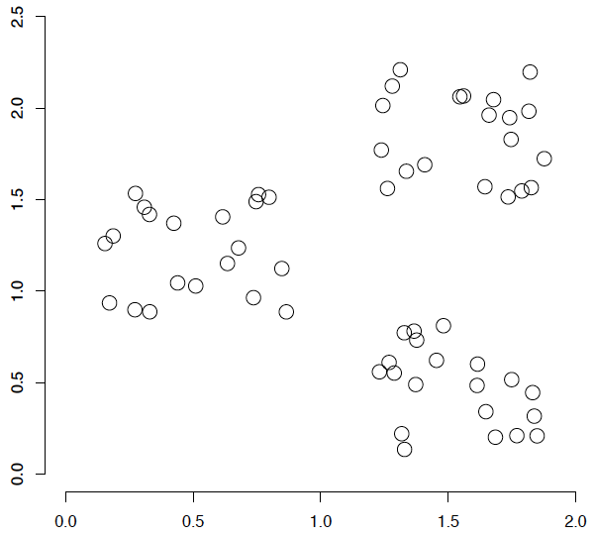
A data set with clear cluster structure
Ch. 16
How would you design an algorithm for finding the three clusters in this case?

Slide 5
Applications of clustering in IR (Information Retrieval)
Sec. 16.1
Whole corpus analysis/navigation
  Better user interface: search without typing
For improving recall in search applications
  Better search results (like pseudo RF)
For better navigation of search results
  Effective “user recall” will be higher
For speeding up vector space retrieval
  Cluster-based retrieval gives faster search

Slide 6
Yahoo! Hierarchy isn’t clustering but is the kind of output you want from clustering
www.yahoo.com/Science
… (30)
agriculture
biology
physics
CS
space
...
...
...
...
...
dairy
crops
botany
cell
AI
courses
craft
magnetism
HCI
missions
forestry
agronomy
evolution
relativity
Notes:
Final data set:
Yahoo Science hierarchy, consisting of text of web pages pointed to by Yahoo, gathered summer of 1997.
264 classes, only sample shown here.

Slide 7
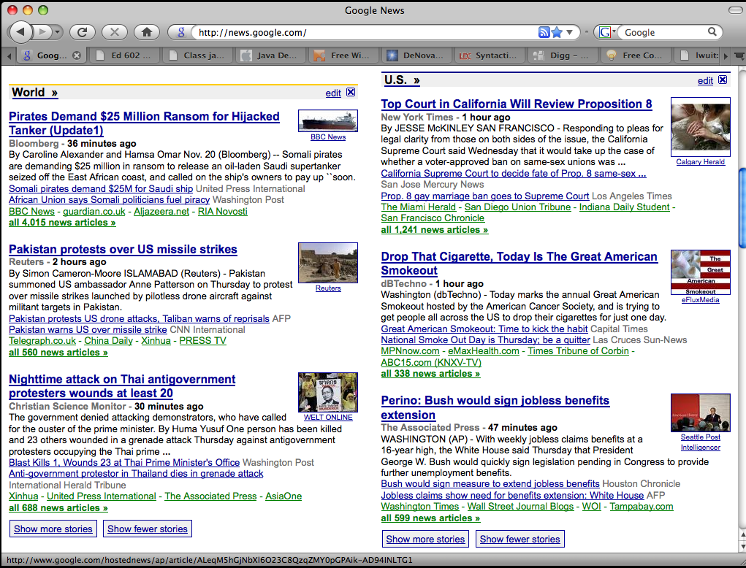
Google News: automatic clustering gives an effective news presentation metaphor

Slide 8
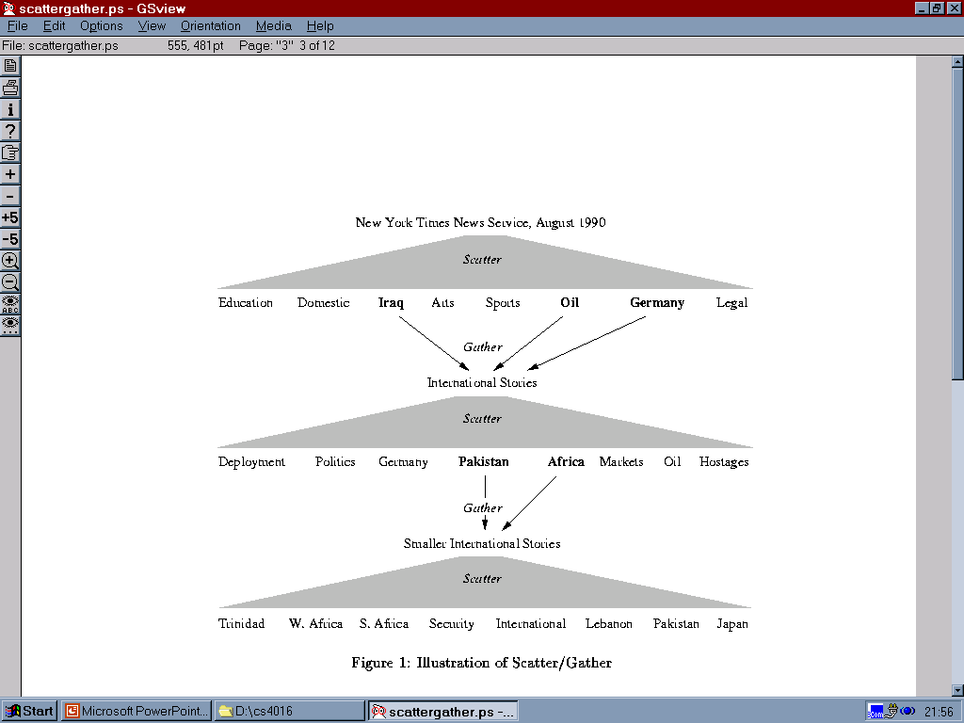
Scatter/Gather: Cutting, Karger, and Pedersen
Sec. 16.1

Slide 9
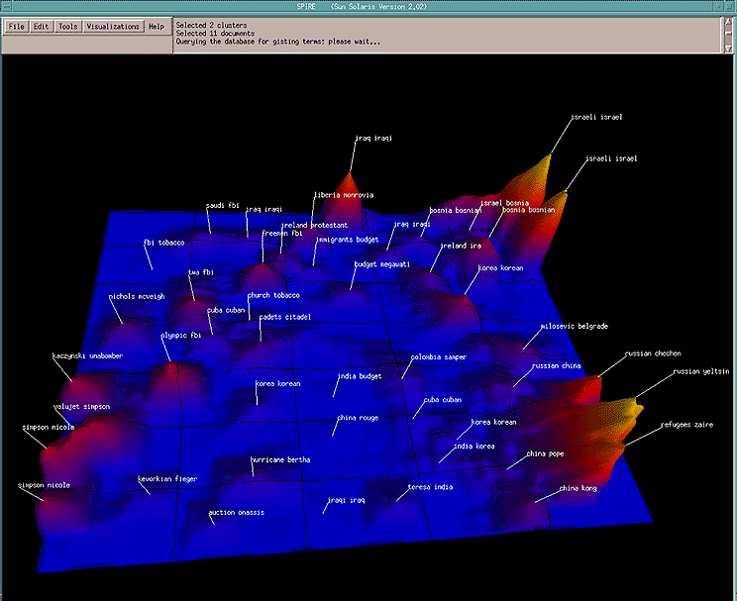
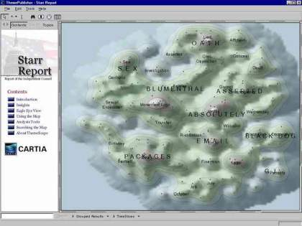
For visualizing a document collection and its themes
Wise et al, “Visualizing the non-visual” PNNL
ThemeScapes, Cartia
  [Mountain height = cluster size]

Slide 10
For improving search recall
Sec. 16.1
Cluster hypothesis - Documents in the same cluster behave similarly with respect to relevance to information needs
Therefore, to improve search recall:
  Cluster docs in corpus a priori
  When a query matches a doc D, also return other docs in the cluster containing D
Hope if we do this: The query “car” will also return docs containing automobile
  Because clustering grouped together docs containing car with those containing automobile.
Why might this happen?

Slide 11
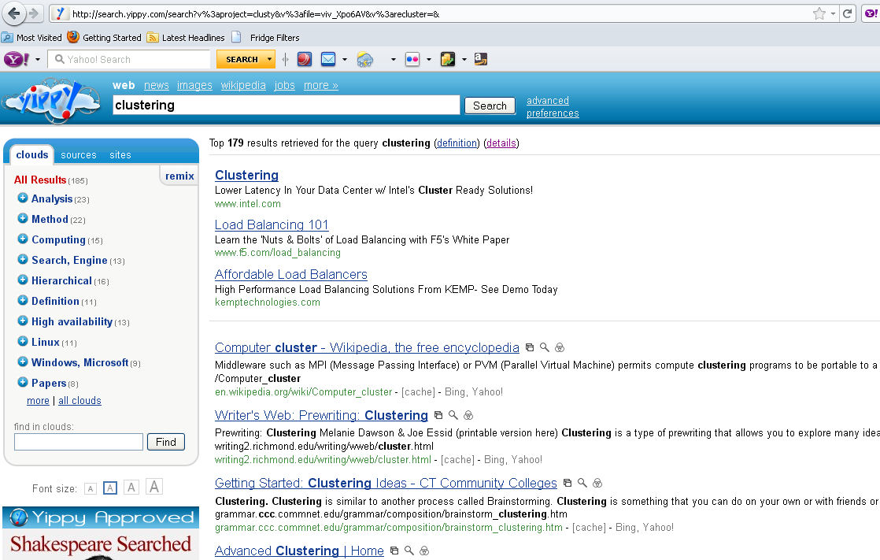
yippy.com – grouping search results

Slide 12
Issues for clustering
Sec. 16.2
Representation for clustering
  Document representation
    Vector space? Normalization?
      Centroids aren’t length normalized
  Need a notion of similarity/distance
How many clusters?
  Fixed a priori?
  Completely data driven?
    Avoid “trivial” clusters - too large or small
      If a cluster's too large, then for navigation purposes you've wasted an extra user click without whittling down the set of documents much.

Slide 13
Notion of similarity/distance
Ideal: semantic similarity.
Practical: term-statistical similarity
  We will use cosine similarity.
  Docs as vectors.
  For many algorithms, easier to think in terms of a distance (rather than similarity) between docs.
  We will mostly speak of Euclidean distance
    But real implementations use cosine similarity

Slide 14
Clustering Algorithms
Flat algorithms
  Usually start with a random (partial) partitioning
  Refine it iteratively
    K means clustering
    (Model based clustering)
Hierarchical algorithms
  Bottom-up, agglomerative
  (Top-down, divisive)

Slide 15
Hard vs. soft clustering
Hard clustering: Each document belongs to exactly one cluster
  More common and easier to do
Soft clustering: A document can belong to more than one cluster.
  Makes more sense for applications like creating browsable hierarchies
  You may want to put a pair of sneakers in two clusters: (i) sports apparel and (ii) shoes
  You can only do that with a soft clustering approach.

Slide 16
Partitioning Algorithms
Partitioning method: Construct a partition of n documents into a set of K clusters
Given: a set of documents and the number K
Find: a partition of K clusters that optimizes the chosen partitioning criterion
  Globally optimal
    Intractable for many objective functions
    Ergo, exhaustively enumerate all partitions
  Effective heuristic methods: K-means and K-medoids algorithms

Slide 17
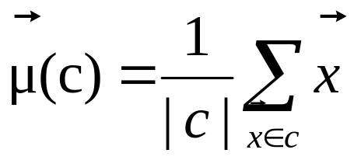
K-Means
Sec. 16.4
Assumes documents are real-valued vectors.
Clusters based on centroids (aka the center of gravity or mean) of points in a cluster, c:
Reassignment of instances to clusters is based on distance to the current cluster centroids.
  (Or one can equivalently phrase it in terms of similarities)

Slide 18
K-Means Algorithm
Sec. 16.4
Select K random docs {s₁, s₂,… s_{K}} as seeds.
Until clustering converges (or other stopping criterion):
For each doc d_{i}:
Assign d_{i} to the cluster c_{j} such that dist(x_{i}, s_{j}) is minimal.
(Next, update the seeds to the centroid of each cluster)
For each cluster c_{j}
s_{j} = μ(c_{j})

Slide 19
K Means Example
(K=2)
Sec. 16.4
Pick seeds
Reassign clusters
Compute centroids
Reassign clusters
x
x
x
Compute centroids
x
x
x
Reassign clusters
Converged!

Slide 20
Termination conditions
Sec. 16.4
Several possibilities, e.g.,
  A fixed number of iterations.
  Doc partition unchanged.
  Centroid positions don’t change.
Does this mean that the docs in a cluster are unchanged?

Slide 21
Convergence
Sec. 16.4
Why should the K-means algorithm ever reach a fixed point?
  A state in which clusters don’t change.
K-means is a special case of a general procedure known as the Expectation Maximization (EM) algorithm.
  EM is known to converge.
  Number of iterations could be large.
      But in practice usually isn’t

Slide 22
Convergence of K-Means
Sec. 16.4
Lower case!
Define goodness measure of cluster k as sum of squared distances from cluster centroid:
  G_{k} = Σ_{i} (d_{i} – c_{k})² (sum over all d_{i} in cluster k)
G = Σ_{k} G_{k}
Reassignment monotonically decreases G since each vector is assigned to the closest centroid.

Slide 23
Convergence of K-Means
Sec. 16.4
Recomputation monotonically decreases each G_{k} since (m_{k} is number of members in cluster k):
  Σ (d_{i} – a)² reaches minimum for:
  Σ –2(d_{i} – a) = 0
  Σ d_{i} = Σ a
  m_{K} a = Σ d_{i}
  a = (1/ m_{k}) Σ d_{i} = c_{k}
K-means typically converges quickly

Slide 24
Time Complexity
Sec. 16.4
Computing distance between two docs is O(M) where M is the dimensionality of the vectors.
Reassigning clusters: O(KN) distance computations, or O(KNM).
Computing centroids: Each doc gets added once to some centroid: O(NM).
Assume these two steps are each done once for I iterations: O(IKNM).

Slide 25

Seed Choice
Sec. 16.4
Results can vary based on random seed selection.
Some seeds can result in poor convergence rate, or convergence to sub-optimal clusterings.
  Select good seeds using a heuristic (e.g., doc least similar to any existing mean)
  Try out multiple starting points
  Initialize with the results of another method.
Example showing
sensitivity to seeds
In the above, if you start
with B and E as centroids
you converge to {A,B,C}
and {D,E,F}
If you start with D and F
you converge to
{A,B,D,E} {C,F}

Slide 26
K-means issues, variations, etc.
Sec. 16.4
Recomputing the centroid after every assignment (rather than after all points are re-assigned) can improve speed of convergence of K-means
Assumes clusters are spherical in vector space
  Sensitive to coordinate changes, weighting etc.
Disjoint and exhaustive
  Doesn’t have a notion of “outliers” by default
  But can add outlier filtering

Slide 27
How Many Clusters?
Number of clusters K is given
  Partition n docs into predetermined number of clusters
Finding the “right” number of clusters is part of the problem
  Given docs, partition into an “appropriate” number of subsets.
  E.g., for query results - ideal value of K not known up front - though UI may impose limits.
Can usually take an algorithm for one flavor and convert to the other.

Slide 28
K not specified in advance
Say, the results of a query.
Solve an optimization problem: penalize having lots of clusters
  application dependent, e.g., compressed summary of search results list.
Tradeoff between having more clusters (better focus within each cluster) and having too many clusters

Slide 29
K not specified in advance
Given a clustering, define the Benefit for a doc to be the cosine similarity to its centroid
Define the Total Benefit to be the sum of the individual doc Benefits.
Why is there always a clustering of Total Benefit n?

Slide 30
Penalize lots of clusters
For each cluster, we have a Cost C.
Thus for a clustering with K clusters, the Total Cost is KC.
Define the Value of a clustering to be =
  Total Benefit - Total Cost.
Find the clustering of highest value, over all choices of K.
  Total benefit increases with increasing K. But can stop when it doesn’t increase by “much”. The Cost term enforces this.

Slide 31
Hierarchical Clustering
Ch. 17
Build a tree-based hierarchical taxonomy (dendrogram) from a set of documents.
One approach: recursive application of a partitional clustering algorithm.
animal
vertebrate
invertebrate
fish reptile amphib. mammal worm insect crustacean

Slide 32
Dendrogram: Hierarchical Clustering
  Clustering obtained by cutting the dendrogram at a desired level: each connected component forms a cluster.

Slide 33
Hierarchical Agglomerative Clustering (HAC)
Sec. 17.1
Starts with each doc in a separate cluster
  then repeatedly joins the closest pair of clusters, until there is only one cluster.
The history of merging forms a binary tree or hierarchy.
Note: the resulting clusters are still “hard” and induce a partition

Slide 34
Closest pair of clusters
Sec. 17.2
Many variants to defining closest pair of clusters
Single-link
  Similarity of the most cosine-similar (single-link)
Complete-link
  Similarity of the “furthest” points, the least cosine-similar
Centroid
  Clusters whose centroids (centers of gravity) are the most cosine-similar
Average-link
  Average cosine between pairs of elements

Slide 35
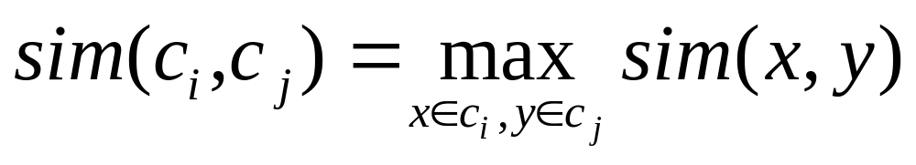
Single Link Agglomerative Clustering
Sec. 17.2
Use maximum similarity of pairs:
Can result in “straggly” (long and thin) clusters due to chaining effect.
After merging c_{i} and c_{j}, the similarity of the resulting cluster to another cluster, c_{k}, is:

Slide 36
Single Link Example
Sec. 17.2

Slide 37
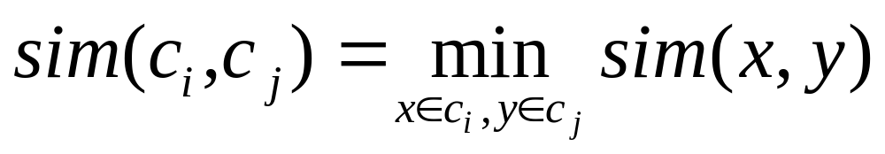
Complete Link
Sec. 17.2
Use minimum similarity of pairs:
Makes “tighter,” spherical clusters that are typically preferable.
After merging c_{i} and c_{j}, the similarity of the resulting cluster to another cluster, c_{k}, is:
C_{i}
C_{j}
C_{k}

Slide 38
Complete Link Example
Sec. 17.2

Slide 39
Computational Complexity
Sec. 17.2.1
In the first iteration, all HAC methods need to compute similarity of all pairs of N initial instances, which is O(N²).
In each of the subsequent N−2 merging iterations, compute the distance between the most recently created cluster and all other existing clusters.
In order to maintain an overall O(N²) performance, computing similarity to each other cluster must be done in constant time.
  Often O(N³) if done naively or O(N² log N) if done more cleverly

Slide 40
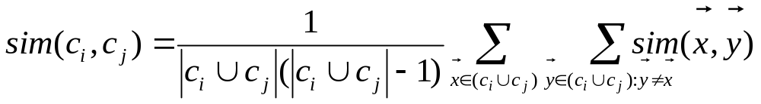
Group Average
Sec. 17.3
Similarity of two clusters = average similarity of all pairs within merged cluster.
Compromise between single and complete link.
Two options:
  Averaged across all ordered pairs in the merged cluster
  Averaged over all pairs between the two original clusters
No clear difference in efficacy

Slide 41
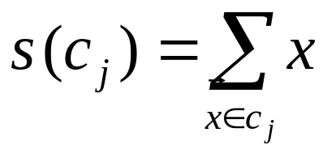
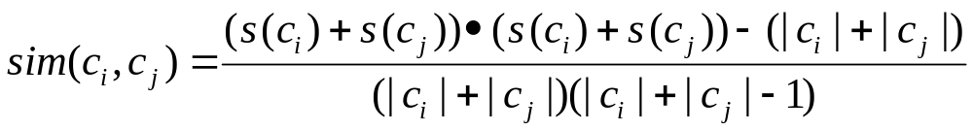
Computing Group Average Similarity
Sec. 17.3
Always maintain sum of vectors in each cluster.
Compute similarity of clusters in constant time:

Slide 42
What Is A Good Clustering?
Sec. 16.3
Internal criterion: A good clustering will produce high quality clusters in which:
  the intra-class (that is, intra-cluster) similarity is high
  the inter-class similarity is low
  The measured quality of a clustering depends on both the document representation and the similarity measure used

Slide 43
External criteria for clustering quality
Sec. 16.3
Quality measured by its ability to discover some or all of the hidden patterns or latent classes in gold standard data
Assesses a clustering with respect to ground truth … requires labeled data
Assume documents with C gold standard classes, while our clustering algorithms produce K clusters, ω₁, ω₂, …, ω_{K} with n_{i} members.

Slide 44
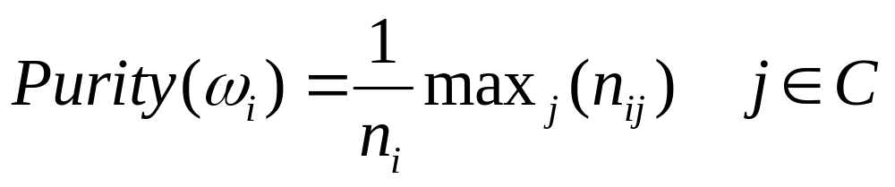
External Evaluation of Cluster Quality
Sec. 16.3
Simple measure: purity, the ratio between the dominant class in the cluster π_{i} and the size of cluster ω_{i}
Biased because having n clusters maximizes purity
Others are entropy of classes in clusters (or mutual information between classes and clusters)

Slide 45
Purity example
Sec. 16.3
• •
• •
• •
• •
• •
• •
• •
• •
•
Cluster I
Cluster II
Cluster III
Cluster I: Purity = 1/6 (max(5, 1, 0)) = 5/6
Cluster II: Purity = 1/6 (max(1, 4, 1)) = 4/6
Cluster III: Purity = 1/5 (max(2, 0, 3)) = 3/5

Slide 46
Rand Index measures between pair decisions. Here RI = 0.68
Sec. 16.3
Number of points | Same Cluster in clustering | Different Clusters in clustering
Same class in ground truth | 20 | 24
Different classes in ground truth | 20 | 72

Slide 47
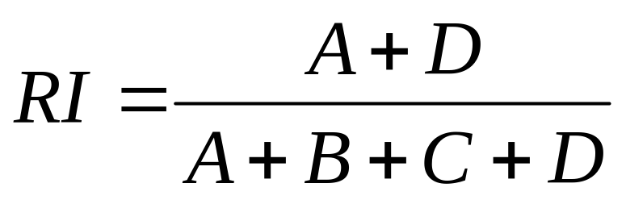

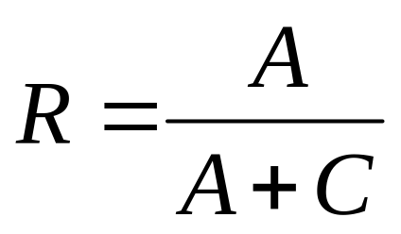
Rand index and Cluster F-measure
Sec. 16.3
Compare with standard Precision and Recall:
People also define and use a cluster F-measure, which is probably a better measure.

Slide 48
Final word and resources
In clustering, clusters are inferred from the data without human input (unsupervised learning)
However, in practice, it’s a bit less clear: there are many ways of influencing the outcome of clustering: number of clusters, similarity measure, representation of documents, . . .

